Slide 1
Agenda
Git and GitHub Basics
Key Git Concepts
Git Workflow
Hands On with Git

Slide 2
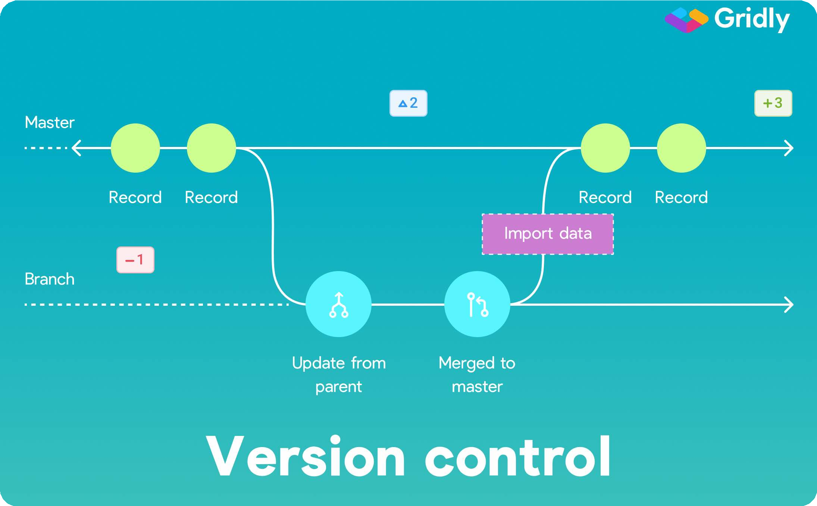

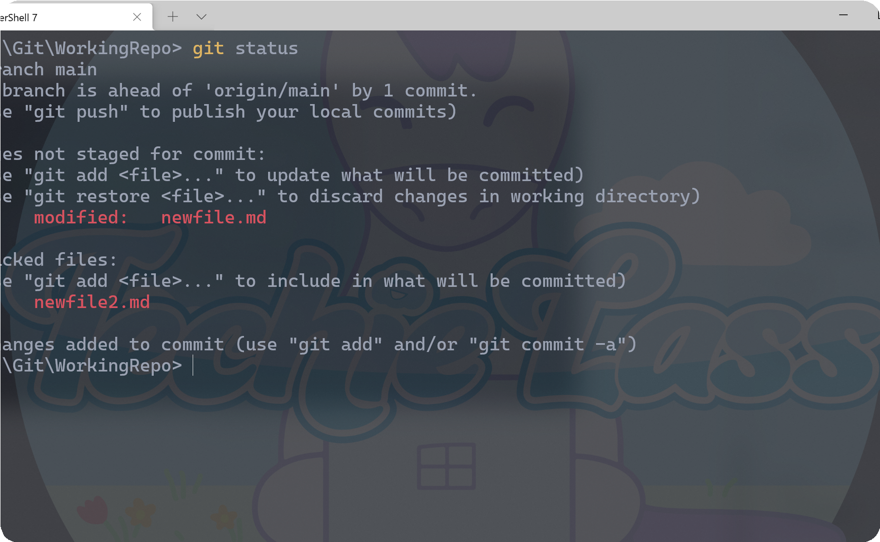
Git and GitHub Basics
Git and Github are essential tools for developers and teams that want to work on projects efficiently and collaboratively.
Version Control
Git provides powerful tools for managing different versions of code, which makes it easier to track changes and manage conflicts.
Collaborating on a Project with Git
Collaborating on projects becomes easier with git. You can collaborate on a project regardless of the location and be sure that everyone has the latest version of the code.
Working with Git Commands
Start working with git and be amazed by its flexibility. T h e s e t u p g u i d e i s g i v e n b e l o w .
Setup Guide : Please click here to open the guide.

Slide 3
Key Git Concepts
Repository:
A repository is a central location where Git stores all the files, history, and metadata related to a project.
Commit:
A commit represents a snapshot of the project at a specific point in time.
It records the changes made to the files in the repository, along with a commit message describing the changes.
Branch:
A branch is a separate line of development within a repository.
It allows multiple versions of the project to exist simultaneously, enabling developers to work on different features or bug fixes independently.
Merge:
Merge is the process of combining changes from one branch into another.

Slide 4
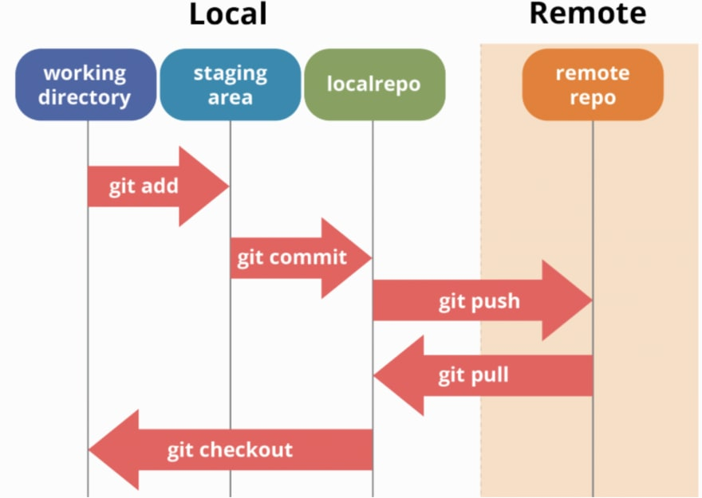
Git Workflow Diagram

Slide 5
Git Workflow
Clone: Creating a local copy of a repository
Add: Staging changes for commit
Commit: Saving changes with a message
Push: Publishing changes to a remote repository
Fork: Creating a personal copy of a repository under your own GitHub account

Slide 6
Git Branches and Merges
Branching and merging are crucial aspects of Git that facilitate efficient parallel development and seamless integration of changes.
Parallel Development
Isolation and Experimentation
Collaboration and Code Review
Feature Development and Bug Fixes
Merging Changes
Conflict Resolution

Slide 7
Hands On with Git

Slide 8
Git Commands
Clone: Creating a local copy of a repository
Add: Staging changes for commit
Commit: Saving changes with a message
Push: Publishing changes to a remote repository
Fork: Creating a personal copy of a repository under your own GitHub account, allowing you to make changes without affecting the original project

Slide 9
Git Workflow
Clone: Creating a local copy of a repository
Add: Staging changes for commit
Commit: Saving changes with a message
Push: Publishing changes to a remote repository
Fork: Creating a personal copy of a repository under your own GitHub account, allowing you to make changes without affecting the original project

Slide 10
Git Workflow
Clone: Creating a local copy of a repository
Add: Staging changes for commit
Commit: Saving changes with a message
Push: Publishing changes to a remote repository
Fork: Creating a personal copy of a repository under your own GitHub account, allowing you to make changes without affecting the original project

